Slide 1
STC NETWORK
Mohammad Mustafa Ahmedzai
Entrepreneur, SEO Consultant,
Premium AdSense Publisher
& Web Developer
Founder:
www.MyBloggerTricks.com
www.SmartEarningMethods.com

Slide 2
“Make Money Online From your Living Room!”

Slide 3
The Plastic bag Seller
Used to sell shopping bags and China Locks (Grade: 2)
Worked at a Decoration Shop for 2 years for Rs. 100/week (Grade: 4)
Moved to Karachi in 2000
Was mocked for being an ‘Akhroat’ for 2 years
Was Disqualified for a US Visa
The same ‘Akhroat’ is now being read by 32,000 People Worldwide for his articles on Web Technology

Slide 4
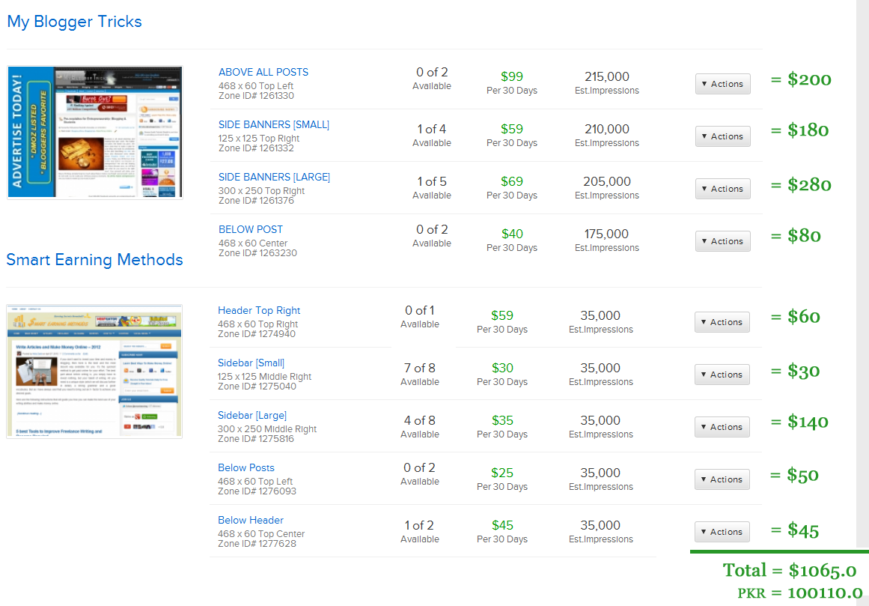

Slide 5
HAVE YOU TRIED BLOGGER?

Slide 6
Things to do (Six Months):
Get familiar with Web designing
HTML, CSS (w3schools.com)
Practice Photoshop
Create a blog
Customize it!
*Optimize it! SEO
Monetize it!
>> continue….

Slide 7
Things to do (Six Months):
Create a Freelancing Account:
Elance
oDesk
Guru
Freelancer
Fiverr
Read Blogs & build links
Develop Skills
Reference: http://www.smartearningmethods.com/2012/03/2012-freelancing-sites-jobs-money/

Slide 8
My Online Earning Strategy
Search Engine Optimization (SEO)?
Advertisement ?
Social Media ?
Baba Bangali?
Or any Other ?

Slide 9
Thank you! ☺

